Slide 1

COMP1679- COURSEWORK PRESENTATION
Trevor Kiggundu

Slide 2
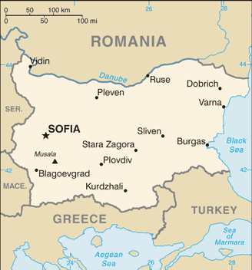

Business Background
What was the situation?
Retrospective/Current situation: The COVID-19 pandemic brought along a great deal of changes for most of the world; technology companies were retrospectively impacted by these changes to peoples lifestyles.
Even companies as complex, large and successful as Google, had to make rapid changes and revisions to their already existing systems, in order to adapt to the changing times and requirements.
A friend of mine worked as an outsourced Google employee in Sofia, Bulgaria, and they were heavily involved with the change management processes, specifically those surrounding Google’s information management systems.

Slide 3



Main Issues
What were the main issues?
Stakeholder Management: Rebranding of Google mainstays, such as ‘GSuite’: Stakeholders had mixed reviews to the changes Google had to make; a lot of apps were repackaged because of the COVID-19 impact. You unfortunately, can’t please everybody.
New Competition: Competitors were taking advantage of the lack of ‘Mainstream’ services for people to stay connected with large groups of people virtually via video. ”Just Google it!”
Apps like ‘Zoom’ and ‘HouseParty’ started boasting a wider array of video chat features to connect people in isolation.
Apps like Microsoft’s ‘Teams’,(ironically, we’re using it now), and Zoom were able to sign contracts with learning institutions to provide online learning. Google did the same, but there were issues.
Extended ‘Google Classroom’ features: This brought an array of IS issues, such as constant updates, updates to legal permissions. More sinister: students taking advantage, 3rd parties entering lectures, changing Admin permissions in the Google Admin console etc.
Time Constraints: Google had to adapt quickly to the changing times as mentioned earlier.

Slide 4

Analytical Frameworks
What frameworks are you considering using, and why?
SWOT: Good way to outline all of Google’s issues at the time, and the format of the grid is also easy to read and understand.
CATWOE: Good way to outline all the the stakeholders involved, and their views on the changes.
ISO Risk Management Matrices: Puts into perspective the risks/issues Google had at the time.
PACEY: Good to understand the cultural and organizational impacts of Google’s changes, as the pandemic affected everyone worldwide.
PESTLE: Good to outline the Legal, Social, Professional and Ethical implications (LSPEi) of Google’s actions. Often overlooked.

Slide 5

Expected Outcomes
Provide an overview of the expected outcomes from the investigation:
Expect to see a great deal of growth and comfort from Google regarding handling these systems now, compared to one year ago when the various countries were thrust into lockdown. (this will be done by interviewing employees that are still in Bulgaria).
Expect to have a better understanding of real-life change management examples; the pandemic brought along a large enough shake up that literally everyone had to make changes; also easier to analyze bigger companies, especially ones with features that I use/have used.
Expect to gain a better understanding of the more theoretical aspect of IT through the investigation, as a large focus of the field ‘concentrates’ around practical elements, like programming.

Slide 6

Conclusion
Thank you for listening!

